Slide 1
Welcome to
1st
GRADE
Mrs. Cochran
Room 108
mrscochran@skdschool.org
Notes:
Search: Welcome

Slide 2
Our Website
http://donnacochran1.weebly.com/
You can use this link or access the site through the school website. Your child’s weekly homework, announcements and other information can be found here.
Notes:
Search: internet

Slide 3
Religion
Creation
Blessed Trinity
Jesus, Mary & Joseph
Christmas
Easter
Baptism
Saints
The Church
Notes:
Search: paint

Slide 4
Reading
Journeys Reading series
Finish a unit every 5 weeks
10 to 15 new words each week
New Phonics skills introduced each week and reviewed daily
Spelling test each week
Notes:
Search: Read

Slide 5
Grammar/Writing
Nouns
Verbs
Adjectives
Types of sentences
Creative Writing - stories, poems
Inventive spelling
Notes:
Search: Pencil

Slide 6
Math
Number sequence to 120
Addition and Subtraction to 20
Clocks
Time
2 digit addition and subtraction
Graphing
3D shapes
Notes:
Search: Math

Slide 7
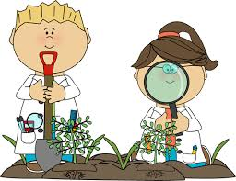
Science
Scholastic Science Spin
Our senses
Apples
Bats
Polar Bears
Penguins
Seasons
Butterflies/insects
STEM activities
Notes:
Search: Science

Slide 8
Social Studies
Scholastic News Weekly Reader
Our Community
Famous People
Holidays
President’s Day
American Symbols
Notes:
Search: Read

Slide 9
TECHNOLOGY
Websites to practice skills.
IXL
EPIC BOOKS
KAHOOT
We will also use:
Digital centers
BOOM cards
SEESAW
GOOGLE Classroom
Notes:
Search: school

Slide 10
Additional Information
Brag Tags/Quiet Critters/earn dollars for treasure shopping
Homework/Classwork
Communication
Guest Reader
KAMI APP
Weekly Reading digital graphic organizers
Challenge work/Center activities
Report cards
Writing folder
HB Jesus Party at Conwell Egan
Mercer Museum: Nov. 21, 2023
Crayola Factory: May 22, 2024

Slide 11
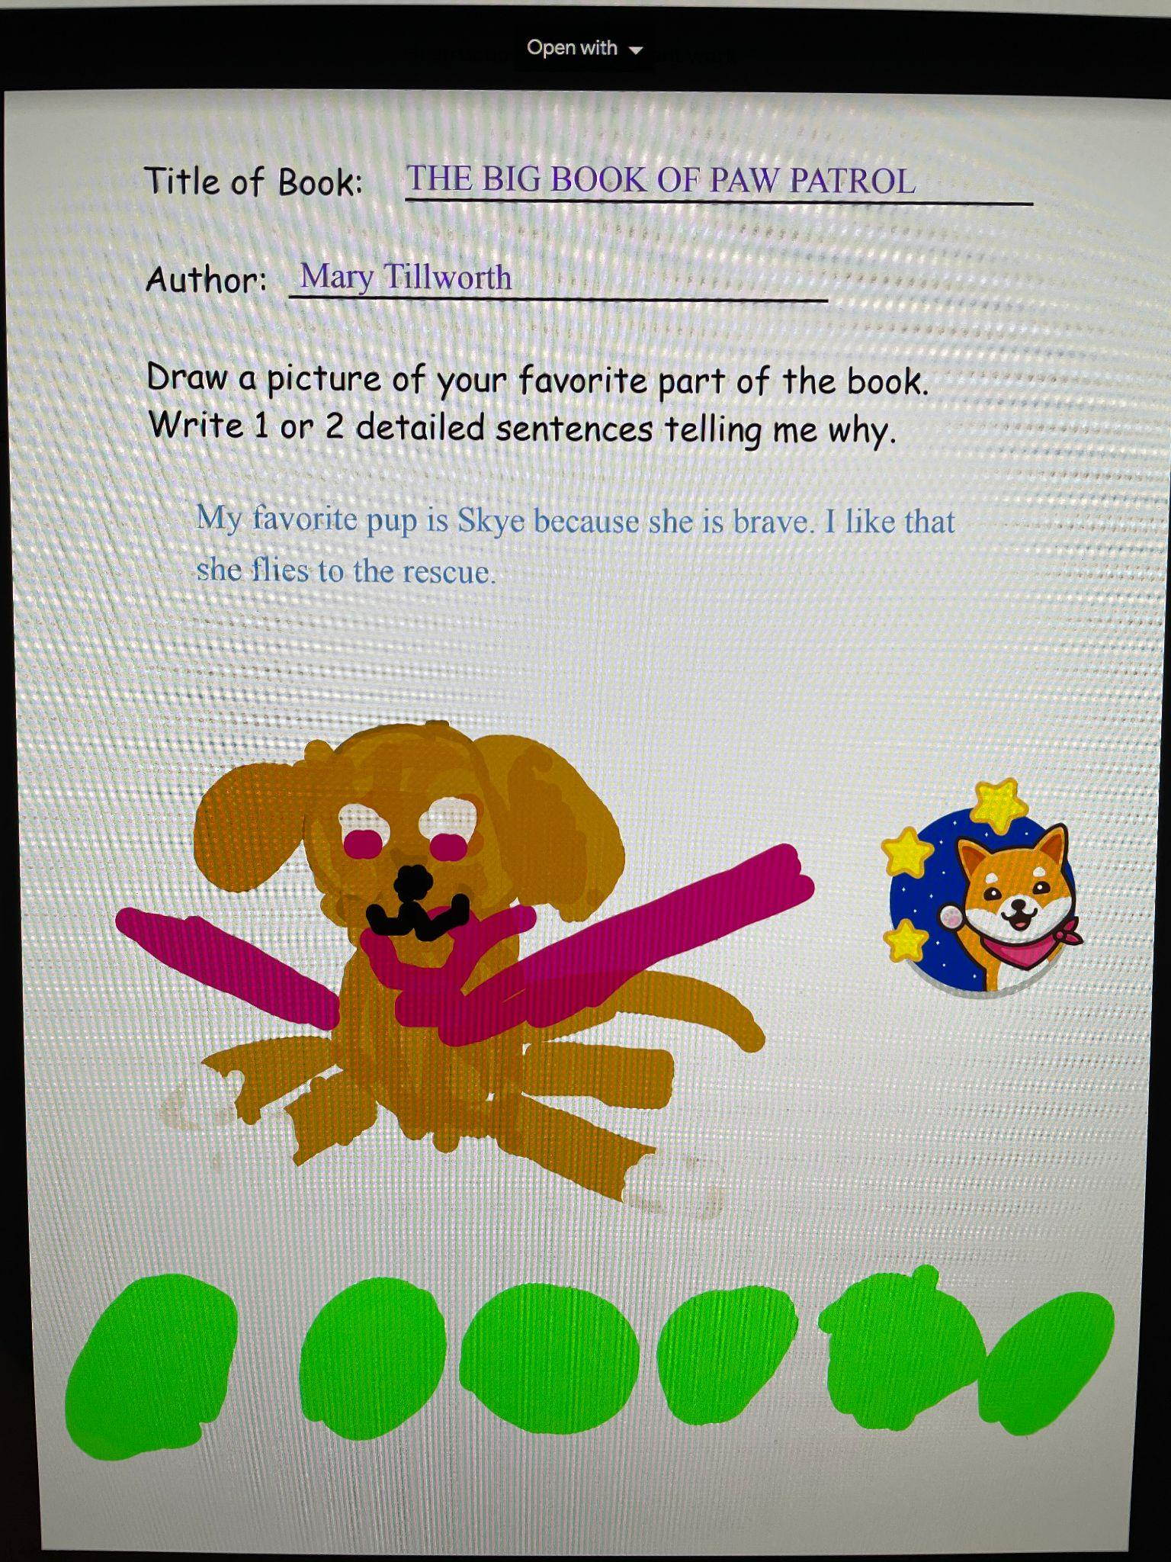
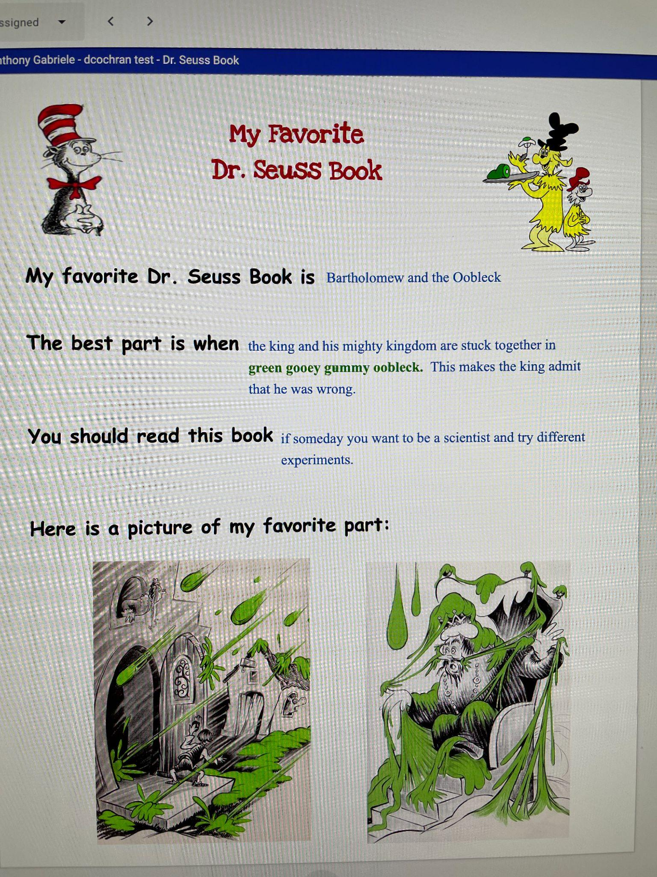

Slide 12
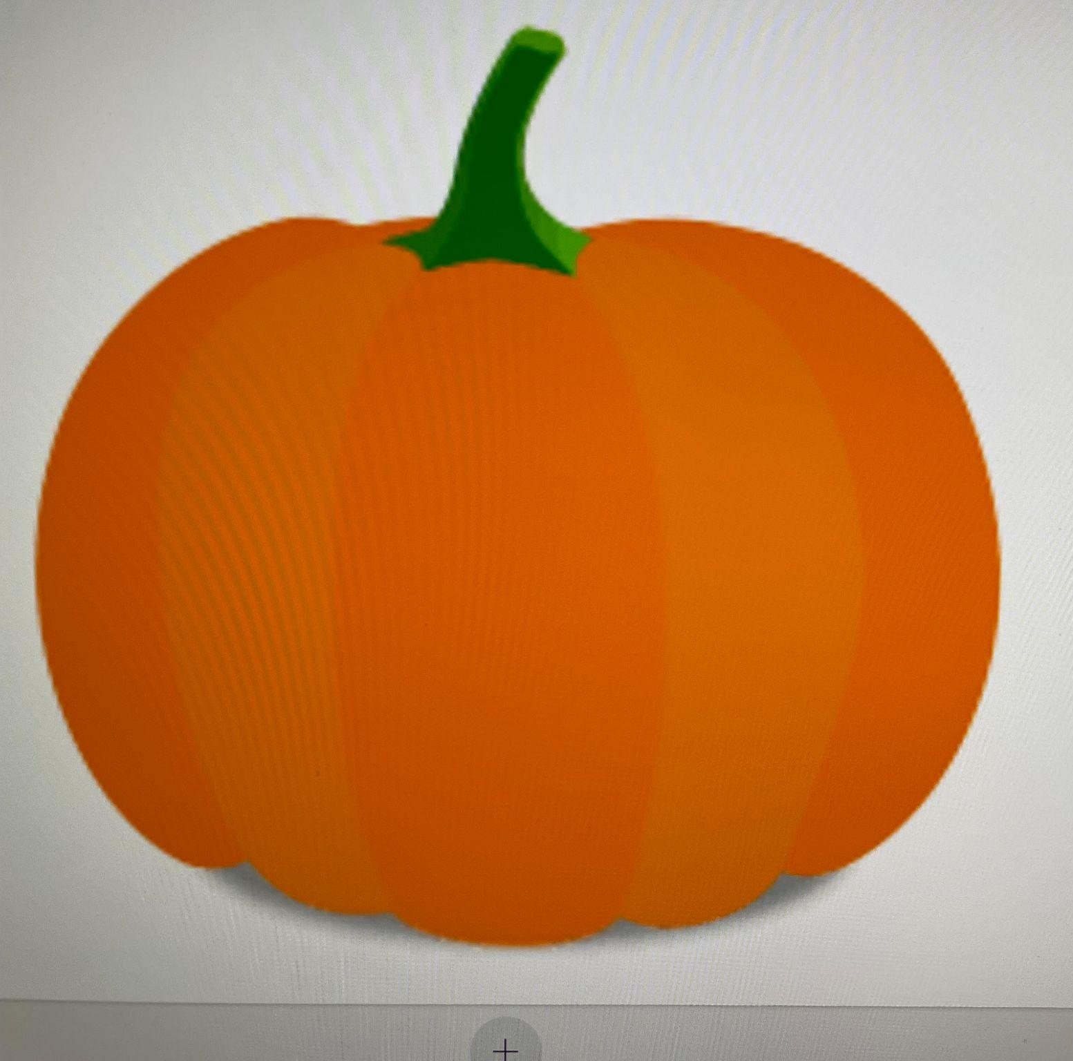
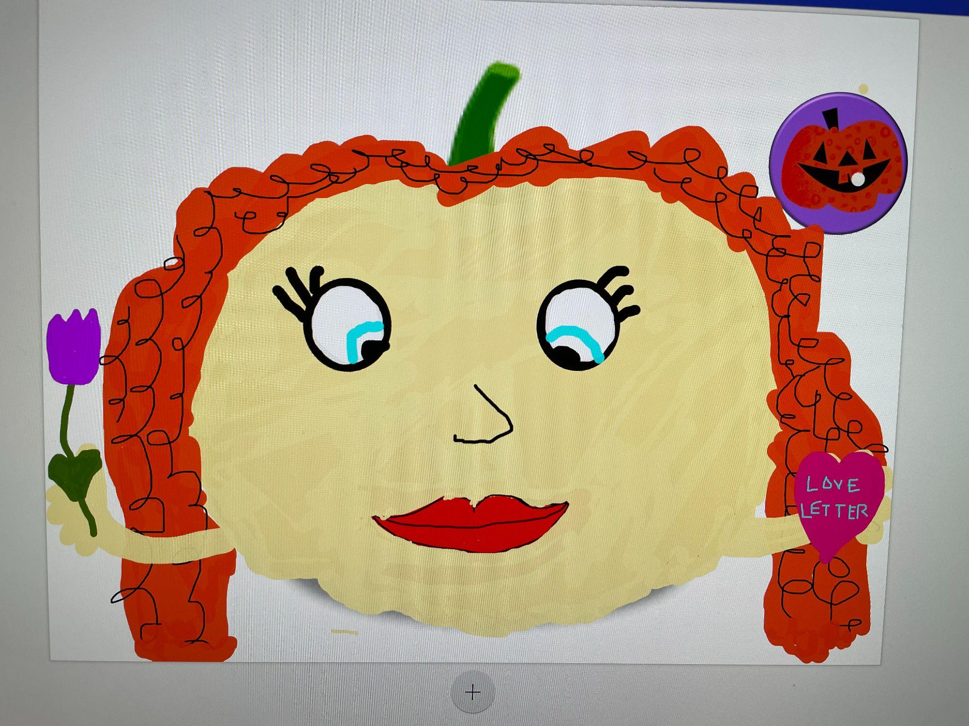
Nancy Clancy

